Slide 1
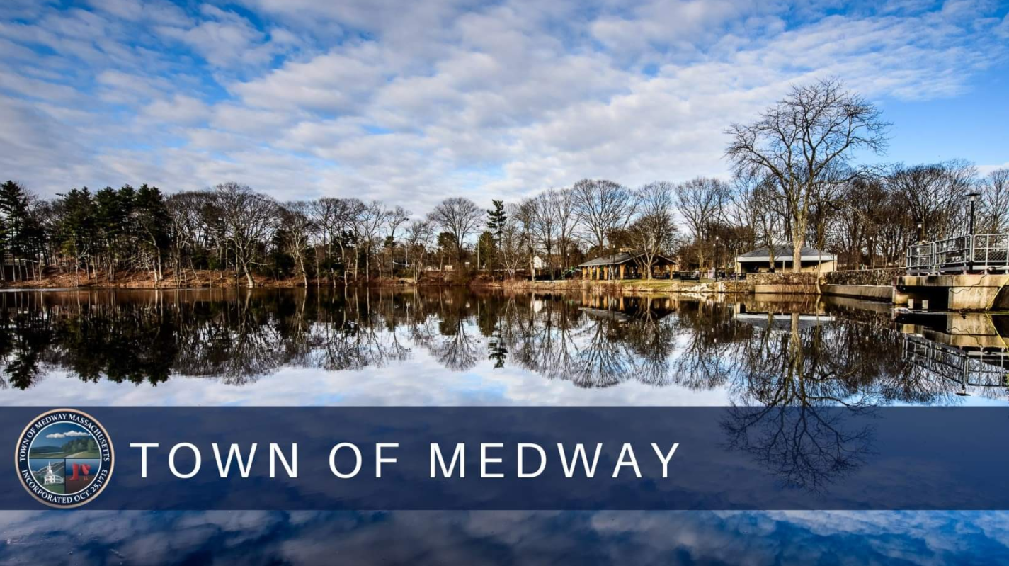
IDEA Committee Community Forum #2

Slide 2
Our Mission Statement
The mission of the Medway Inclusion, Diversity & Equity Advisory (IDEA) Committee is to provide feedback and recommendations to the Select Board geared toward policy development designed to continue and where appropriate enhance the promotion and fostering of Medway as a community that is inclusive and welcoming to all peoples of all backgrounds, beliefs, and cultures.
This mission statement shall in no way be construed to suggest that Medway does not excel in these efforts, but rather seeks to fully explore our standards, our practices, and our collective efforts today and to build upon them for an even better tomorrow.

Slide 3
Quantitative Survey

Slide 4
IDEA COMMITTEE SURVEY
About the Survey
The IDEA committee survey was fielded between May 26th, and September 21st , 2022.
The survey was administered via online platform (TypeForm) and was 100% anonymous.
The survey was completed by n=245 respondents and the median completion time was 8 minutes 44 seconds.
The survey had three main sections:
Recommendations / Experiences (Open-end Response)
Experiences / Opinions
Key Metrics
Agreement Statements
Demographics

Slide 5
IDEA COMMITTEE SURVEY (Respondent Demographics)
Who Took the Survey?
Total Respondents
There were a total of 245 completed surveys. Due to programming error, respondents were not forced to submit a response on all questions. This led to very small differences in some response counts on certain questions (e.g., 243 submitted on certain questions)
Respondent Demographic Skews
Ideally, the demographics of our survey respondents would perfectly reflect the demographic distribution of Medway. However, our survey demographics “skew” in several ways due to random nature of sampling and response:
Respondent Age Skews Older:
Only ~7% of survey respondents were <35 years old
Respondent Gender Skews Slightly Female (maybe):
56% of survey respondents identified as female
34% identified as male
9% preferred not to answer
Respondent Race is :
84% of those that provided racial data identified as White
2020 Medway Master Plan data indicated that 88% of residents identify as White

Slide 6
A few analysis / market research terms
Term: “Statistically Significant” (at 95% Confidence Interval)
Explanation: If there is no difference between two numbers (e.g., avg scores between men and women), then we would expect to see these results less than 5% of the time
Term: “Directional”
Explanation: Results are not statistically significant at 95% confidence level, but might significant if we expanded the sample or lowered our confidence interval requirements
Term: “Top-2 Box Score” or “Bottom-2 Box Score”
Explanation: Percentage of Survey Respondents who answers 6 or 7 (for Top-2 Box) or 1 or 2 (for Bottom 2-Box
Bottom-2 Box
Top-2 Box
1 | 2 | 3 | 4 | 5 | 6 | 7
◉ | ◉ | ◉ | ◉ | ◉ | ◉ | ◉

Slide 7
SURVEY FLOW
Recommendations / Opinions
Open-End Response Option to Capture Initial Thoughts / Opinions
Key Metrics
7-Point Satisfaction Scale Used to Capture Satisfaction with: Medway (Overall), Diversity, Equity, and Inclusion
Experiences
(Multi-Select)
Multi-Select Question Format to Capture Experiences (Either Seen in Medway or Experienced Personally)
Agreement Statements
7-Point Agreement Scale to Capture Level of Agreement with Statements on DEI
Demographics
Battery of Various Demographic Questions
Final Thoughts
Open-End Response Option to Capture Any Remaining Thoughts

Slide 8
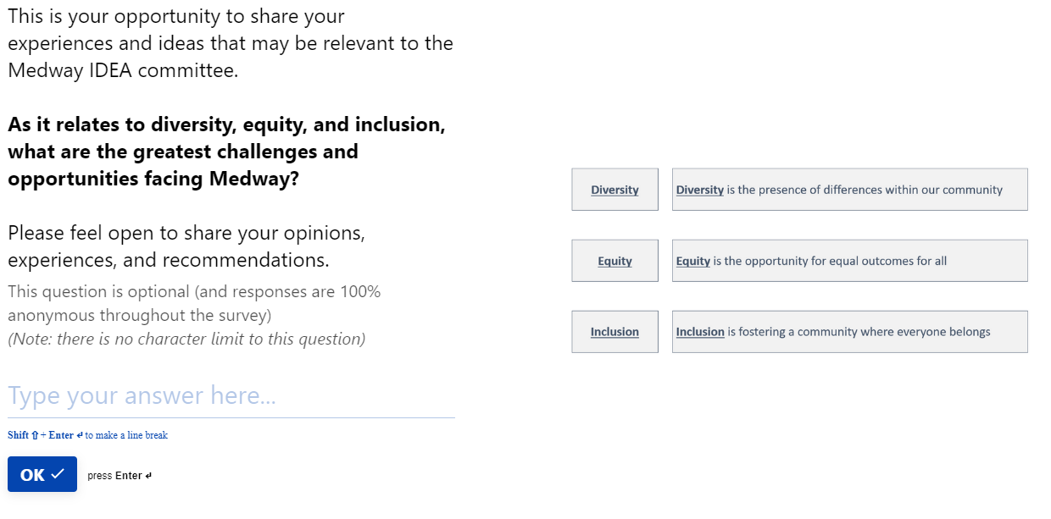
SURVEY FLOW
Recommendations / Opinions
Open-End Response Option to Capture Initial Thoughts / Opinions
Key Metrics
Experiences
(Multi-Select)
Agreement Statements
Demographics
Final Thoughts

Slide 9
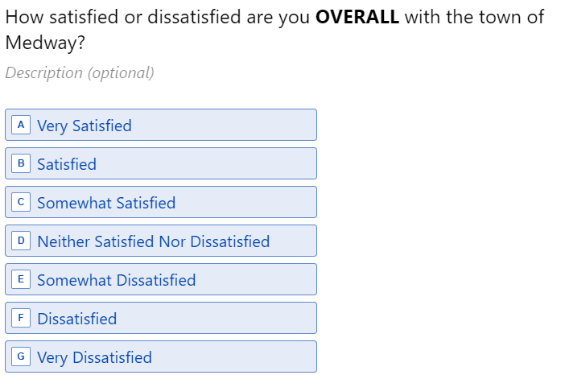
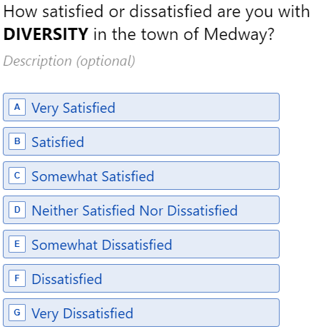
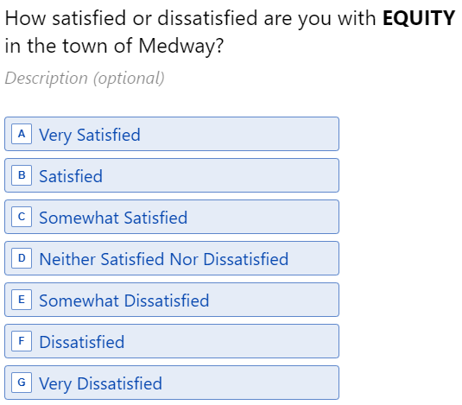
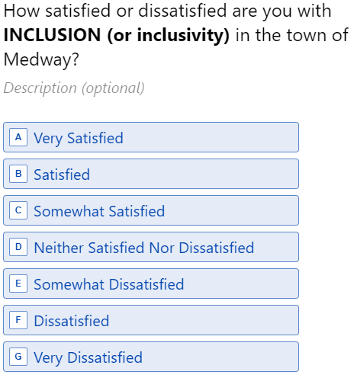
SURVEY FLOW
Recommendations / Opinions
7-Point Satisfaction Scale Used to Capture Satisfaction with: Medway (Overall), Diversity, Equity, and Inclusion
Key Metrics
These four questions generate our “Key Metrics” of Satisfaction:
Overall
Diversity
Equity
Inclusion
The data generated from these questions can be “cut” by different demographics to understand the high-level satisfaction levels of various demographic segments
Experiences
(Multi-Select)
Agreement Statements
Demographics
Final Thoughts

Slide 10
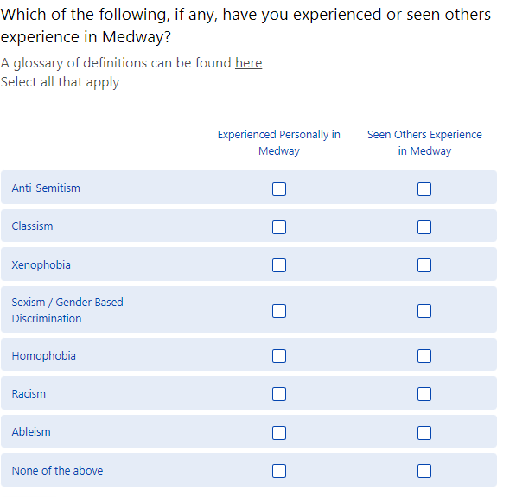
SURVEY FLOW
Recommendations / Opinions
Multi-Select Question Format to Capture Experiences (Either Seen in Medway or Experienced Personally)
7-Point Satisfaction Scale Used to Capture Satisfaction with: Medway (Overall), Diversity, Equity, and Inclusion
Key Metrics
A link to a glossary of the terms was provided to respondents on this page
Experiences
(Multi-Select)
Agreement Statements
Demographics
Final Thoughts

Slide 11
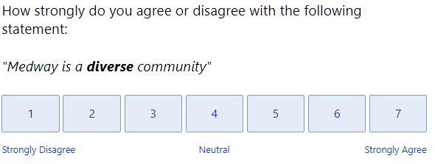
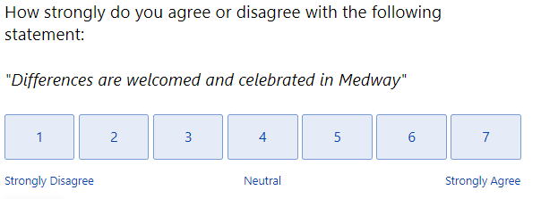
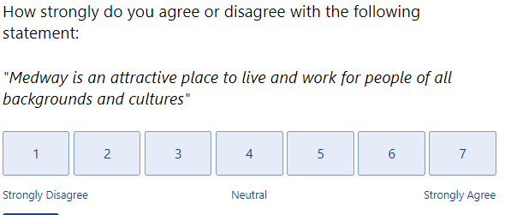
SURVEY FLOW
Recommendations / Opinions
Multi-Select Question Format to Capture Experiences (Either Seen in Medway or Experienced Personally)
7-Point Satisfaction Scale Used to Capture Satisfaction with: Medway (Overall), Diversity, Equity, and Inclusion
7-Point Agreement Scale to Capture Level of Agreement with Statements on DEI
Key Metrics
Question Stem: “How Strongly do you agree or disagree with the following statement:”
Statements Displayed:
Medway is a diverse community
Medway is an equitable community
Medway is an inclusive community
"Medway is able to attract, hire, and retain talent of all backgrounds and cultures“
"Medway is an attractive place to live and work for people of all backgrounds and cultures“
"When making decisions, the Town of Medway proactively considers all of its residents (including me and people like me)“
"Differences are welcomed and celebrated in Medway“
"I know how to bring about the changes I want to see in Medway
"I feel comfortable talking about diversity and race in Medway“
"I feel comfortable expressing myself fully (including my beliefs, identity, and culture)“
"Conversations in the community about diversity, equity, and inclusion are respectful and productive"
Select Screenshots
Experiences
(Multi-Select)
Agreement Statements
Demographics
Final Thoughts

Slide 12
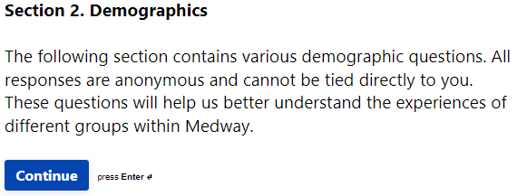
SURVEY FLOW
Recommendations / Opinions
Various Demographic Questions
Multi-Select Question Format to Capture Experiences (Either Seen in Medway or Experienced Personally)
7-Point Satisfaction Scale Used to Capture Satisfaction with: Medway (Overall), Diversity, Equity, and Inclusion
7-Point Agreement Scale to Capture Level of Agreement with Statements on DEI
Demographic Question Categories
Key Metrics
All respondents were displayed a reminder that all responses are anonymous and cannot be tied directly to them personally
Experiences
(Multi-Select)
Agreement Statements
Medway Status (Live in Medway, Work in Medway, etc)
Length of Residency
Length of Time Working in Medway
Age
Gender
Sexual Orientation
Race
Spanish, Hispanic, or of Latino Origin
Ethnicity
Religion
Children under 18
Disability Status
Veteran Status
Household Income
Home Ownership Status (Rent vs Own)
Primary Language Spoken in Home
Demographics
Final Thoughts

Slide 13
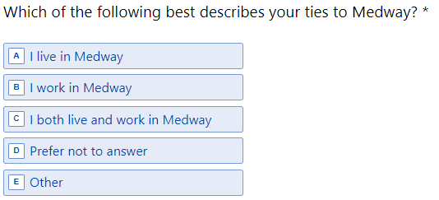
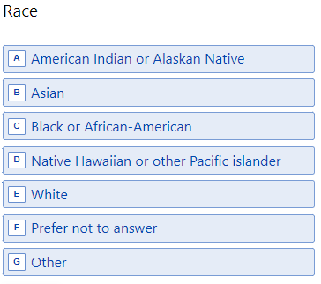
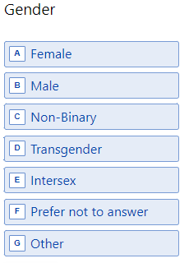
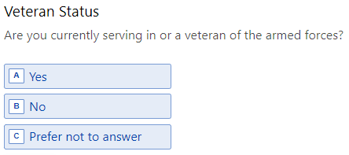
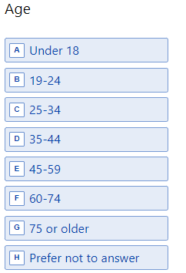
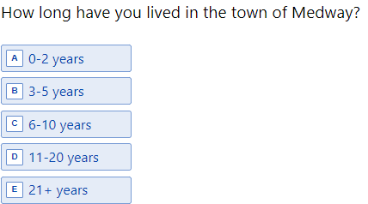
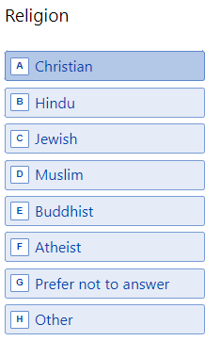
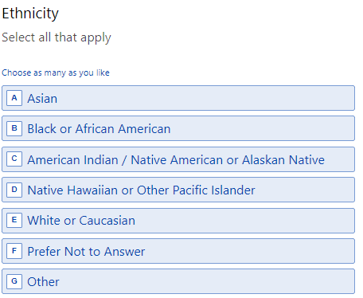
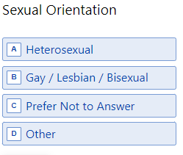
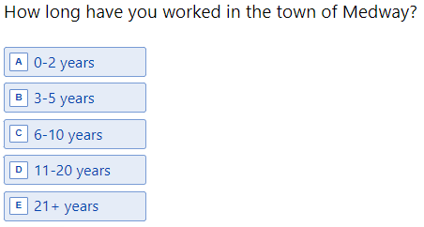
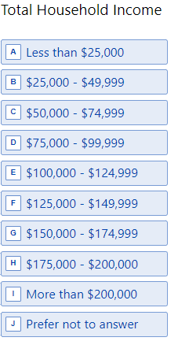
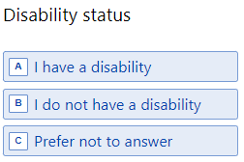
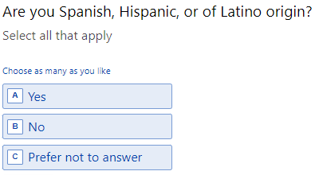
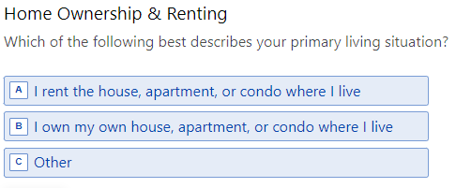
SURVEY FLOW
Recommendations / Opinions
Various Demographic Questions
Multi-Select Question Format to Capture Experiences (Either Seen in Medway or Experienced Personally)
7-Point Satisfaction Scale Used to Capture Satisfaction with: Medway (Overall), Diversity, Equity, and Inclusion
7-Point Agreement Scale to Capture Level of Agreement with Statements on DEI
Demographic Question Screenshots
Key Metrics
Experiences
(Multi-Select)
Agreement Statements
Demographics
Final Thoughts

Slide 14
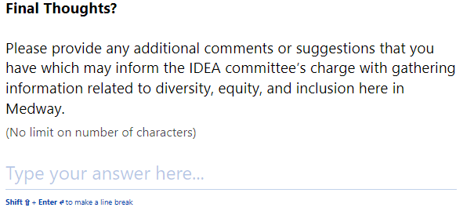
SURVEY FLOW
Recommendations / Opinions
7-Point Satisfaction Scale Used to Capture Satisfaction with: Medway (Overall), Diversity, Equity, and Inclusion
Key Metrics
The survey ended with a final open-end question to capture any final thoughts / opinions / experiences as they relate to the issues of DEI
Experiences
(Multi-Select)
Agreement Statements
Demographics`
Final Thoughts

Slide 15
Survey Data & Findings

Slide 16
SURVEY FLOW
Recommendations / Opinions
Open-End Response Option to Capture Recommendations / Thoughts / Opinions
Key Metrics
Key Topics Found Within Open-End Responses
Diversity, Equity, Inclusion and how it is observed and perceived in our community
Housing and Transportation and the populations they serve. (Ex. no sidewalks/public transportation only attracts people with vehicles, expensive housing prices out lower income families)
Divisions within our community and how we treat each other (Mentions of special interest groups and individuals)
Bullying both by adults and children
Effectiveness of programs and actions within schools (Special education, holiday acknowledgement, hiring practices, etc.)
Experiences
(Multi-Select)
Agreement Statements
Demographics
Final Thoughts
Q. Please provide any additional comments or suggestions that you have which may inform the IDEA committee’s charge with gathering information related to diversity, equity, and inclusion here in Medway.
Q: As it relates to diversity, equity, and inclusion, what are the greatest challenges and opportunities facing Medway?

Slide 17
SURVEY FLOW
Key Metrics
Recommendations / Opinions
Approximately 60% of people say that they are “Satisfied or Very Satisfied” with Medway (overall)
Only 34%-36% say they are “Satisfied or Very Satisfied” with Diversity, Equity, or Inclusion in Medway
Meanwhile 14% -22% are “Dissatisfied or Very Dissatisfied” with Diversity, Equity, or Inclusion in Medway (compared to 5% for Medway - Overall)
Key Metrics
Experiences
(Multi-Select)
Metric | Average (1-7 Scale) | Top-2 Box % | Bottom-2 Box %
Overall Satisfaction | 5.4 | 61% | 5%
Overall Satisfaction with DIVERSITY | 4.5 | 34% | 14%
Overall Satisfaction with EQUITY | 4.5 | 35% | 16%
Overall Satisfaction with INCLUSION | 4.4 | 36% | 22%
Agreement Statements
Demographics
Final Thoughts
Q: As it relates to diversity, equity, and inclusion, what are the greatest challenges and opportunities facing Medway?

Slide 18
Key Metrics – Gender / Sexuality
Gender
Males are directionally less satisfied Overall with Medway than Females
However, Females are directionally less satisfied on Diversity and Inclusion, and significantly less satisfied with Equity
Metric (Top-2 Box %) | Overall (n=245) | Male (n=83) | Female (n=136) | Prefer Not to Answer (n=21)
Overall Satisfaction | 61% | 56% | 64% | 57%
Overall Satisfaction with DIVERSITY | 34% | 35% | 28% | 71%
Overall Satisfaction with EQUITY | 35% | 41% | 24% | 71%
Overall Satisfaction with INCLUSION | 36% | 43% | 26% | 71%
Top-2 Box % = Percentage of respondents that said “Satisfied” or “Very Satisfied”
Only segments with 10+ responses are displayed
Green / Red: Indicate statistically significant difference at 95% CI
Sexuality
Heterosexual respondents are directionally more satisfied across all four key metrics than Gay / Lesbian / Bisexual respondents
Metric (Top-2 Box %) | Overall (n=245) | Heterosexual (n=182) | Gay / Lesbian / Bisexual (n=15) | Prefer Not to Answer (n=44)
Overall Satisfaction | 61% | 61% | 53% | 64%
Overall Satisfaction with DIVERSITY | 34% | 28% | 20% | 66%
Overall Satisfaction with EQUITY | 35% | 28% | 20% | 66%
Overall Satisfaction with INCLUSION | 36% | 31% | 20% | 65%
Top-2 Box % = Percentage of respondents that said “Satisfied” or “Very Satisfied”
Only segments with 10+ responses are displayed

Slide 19
Key Metrics – Race / Age
Race
White respondents are significantly more satisfied than non-white respondents across all four metrics
Black or African-American respondents are the least satisfied across all four metrics
Metric (Top-2 Box %) | Overall (n=245) | White (n=161) | Black or African-American (n=12) | Asian (n=15) | Prefer Not to Answer (n=49)
Overall Satisfaction | 61% | 67% | 17% | 33% | 62%
Overall Satisfaction with DIVERSITY | 34% | 27% | 8% | 13% | 73%
Overall Satisfaction with EQUITY | 35% | 26% | 9% | 26% | 76%
Overall Satisfaction with INCLUSION | 36% | 29% | 8% | 21% | 76%
Top-2 Box % = Percentage of respondents that said “Satisfied” or “Very Satisfied”
Only segments with 10+ responses are displayed
Green / Red: Indicate statistically significant difference at 95% CI
Age
Respondents in 19-34 age segment are significantly less satisfied with Medway (Overall) than
60+ respondents are somewhat more satisfied with Diversity / Equity than they are Inclusion
Metric (Top-2 Box %) | Overall (n=242) | Under 18 (n=10) | 19-34 (n=17) | 35-44 (n=89) | 45-59 (n=92) | 60+ (n=28)
Overall Satisfaction | 61% | 40% | 36% | 63% | 64% | 71%
Overall Satisfaction with DIVERSITY | 34% | 30% | 32% | 32% | 33% | 39%
Overall Satisfaction with EQUITY | 35% | 33% | 31% | 33% | 33% | 43%
Overall Satisfaction with INCLUSION | 36% | 10% | 26% | 37% | 37% | 32%
Top-2 Box % = Percentage of respondents that said “Satisfied” or “Very Satisfied”
Only segments with 10+ responses are displayed

Slide 20
Key Metrics – Religion / Household Income
Religion
Christians are directionally more satisfied across DEI metrics than Atheists and “Other” religions
Metric (Top-2 Box %) | Overall (n=245) | Christian (n=114) | Atheist (n=25) | Other (n=18) | Prefer Not to Answer (n=52)
Overall Satisfaction | 61% | 65% | 60% | 72% | 60%
Overall Satisfaction with DIVERSITY | 34% | 32% | 16% | 22% | 57%
Overall Satisfaction with EQUITY | 35% | 28% | 24% | 28% | 60%
Overall Satisfaction with INCLUSION | 36% | 31% | 24% | 17% | 60%
Top-2 Box % = Percentage of respondents that said “Satisfied” or “Very Satisfied”
Only segments with 10+ responses are displayed
Green / Red: Indicate statistically significant difference at 95% CI
Age
Those with HHI <$75k are significantly less satisfied with Medway Overall than other segments
Metric (Top-2 Box %) | Overall (n=241) | < $75k (n=19) | $75k-$99k (n=19) | $100k-$149k (n=47) | $150k-$200k (n=48) | $200k+ (n=53) | Prefer Not to Answer (n=55)
Overall Satisfaction | 61% | 26% | 60% | 60% | 66% | 64% | 65%
Overall Satisfaction with DIVERSITY | 35% | 32% | 30% | 35% | 25% | 17% | 64%
Overall Satisfaction with EQUITY | 35% | 22% | 35% | 28% | 25% | 25% | 65%
Overall Satisfaction with INCLUSION | 36% | 32% | 37% | 32% | 25% | 26% | 60%
Top-2 Box % = Percentage of respondents that said “Satisfied” or “Very Satisfied”
Segments with smaller sample sizes were grouped together for analysis purposes

Slide 21
Key Metrics – Veteran Status / Disability Status
Veteran Status
Veterans / Members of Armed forces are directionally more satisfied than non-Veterans on DEI metrics
Metric (Top-2 Box %) | Overall (n=241) | Veteran / Member of Armed Forces (n=21) | Non-Veteran (n=204) | Prefer Not to Answer (n=16)
Overall Satisfaction | 61% | 57% | 61% | 63%
Overall Satisfaction with DIVERSITY | 35% | 43% | 32% | 69%
Overall Satisfaction with EQUITY | 35% | 45% | 30% | 81%
Overall Satisfaction with INCLUSION | 36% | 48% | 32% | 75%
Top-2 Box % = Percentage of respondents that said “Satisfied” or “Very Satisfied”
Segments with less than 10 responses were grouped under “Other”
Disability Status
Only directional differences are seen between satisfaction levels for respondents with a disability and those without a disability
Metric (Top-2 Box %) | Overall (n=239) | Have a Disability (n=26) | Does NOT have a disability (n=179) | Prefer not to answer (n=34)
Overall Satisfaction | 61% | 54% | 61% | 65%
Overall Satisfaction with DIVERSITY | 35% | 38% | 28% | 65%
Overall Satisfaction with EQUITY | 35% | 32% | 27% | 73%
Overall Satisfaction with INCLUSION | 36% | 35% | 30% | 62%
Top-2 Box % = Percentage of respondents that said “Satisfied” or “Very Satisfied”
Segments with smaller sample sizes were grouped together for analysis purposes

Slide 22
Key Metrics – Home Ownership / Children in Household
Home Ownership
Those who rent are significantly less satisfied with Medway Overall
Metric (Top-2 Box %) | Overall (n=232) | I own… (n=220) | I rent… (n=12)
Overall Satisfaction | 61% | 64% | 31%
Overall Satisfaction with DIVERSITY | 35% | 35% | 23%
Overall Satisfaction with EQUITY | 35% | 35% | 25%
Overall Satisfaction with INCLUSION | 36% | 36% | 42%
Top-2 Box % = Percentage of respondents that said “Satisfied” or “Very Satisfied”
Segments with less than 10 responses were grouped under “Other”
Children in Household
Minimal differences in satisfaction are seen based-upon Children (<18) in Household vs No-Children
Metric (Top-2 Box %) | Overall (n=241) | Has Children <18 (n=166) | Does NOT Have Children <18 (n=64) | Prefer not to answer (n=11)
Overall Satisfaction | 61% | 61% | 59% | 64%
Overall Satisfaction with DIVERSITY | 35% | 33% | 36% | 64%
Overall Satisfaction with EQUITY | 35% | 32% | 38% | 70%
Overall Satisfaction with INCLUSION | 36% | 36% | 33% | 64%
Top-2 Box % = Percentage of respondents that said “Satisfied” or “Very Satisfied”
Segments with smaller sample sizes were grouped together for analysis purposes

Slide 23
SURVEY FLOW
Experiences: Seen / Experienced
Recommendations / Opinions
Racism (39%) and Classism (36%) were the forms of discrimination most frequently seen experienced by others
Sexism (20%) and Classism (15%) were the forms of discrimination most frequently experienced by respondents personally
Approximately ~2/3 of respondents said they have experienced at least one of the forms of discrimination in our list
Only 30% had not seen others experience the listed forms of discrimination (said “None of the Above”)
Key Metrics
Experiences
(Multi-Select)
Agreement Statements
Demographics
Final Thoughts
Q: Which of the following, if any, have you experienced or seen others experience in Medway?

Slide 24
SURVEY FLOW
Agreement Statements
Recommendations / Opinions
Respondents do not feel that Medway is a diverse community (low Top 2-box and high Bottom-2 box scores)
Respondents also are more likely to feel that conversations about DEI are not respectful and productive
Key Metrics
AGREEMENT STATEMENTS | Top 2 Box Score (% that Agreed or Strongly Agreed) | Bottom 2 Box Score (% that Disagreed or Strongly Disagreed)
Medway is a diverse community | 19% | 33%
Medway is an equitable community | 28% | 17%
Medway is an inclusive community | 31% | 20%
Medway is able to attract, hire, and retain talent of all backgrounds and cultures | 30% | 28%
Medway is an attractive place to live and work for people of all backgrounds and cultures | 36% | 21%
When making decisions, the Town of Medway proactively considers all of its residents (including me and people like me) | 31% | 22%
Differences are welcomed and celebrated in Medway | 28% | 22%
I know how to bring about the changes I want to see in Medway | 26% | 19%
I feel comfortable talking about diversity and race in Medway | 36% | 19%
I feel comfortable expressing myself fully (including my beliefs, identity, and culture) | 39% | 19%
Conversations in the community about diversity, equity, and inclusion are respectful and productive | 16% | 33%
Experiences
(Multi-Select)
Agreement Statements
Demographics
Final Thoughts
Q: “How Strongly do you agree or disagree with the following statement:”

Slide 25
Agreement Statements – All Levels (1-7)

Slide 26
Agreement Statements – Top 2 Box (6-7)
Respondents most frequently agree that:
“Medway is an attractive place to live and work for all…”
“I feel comfortable expressing myself fully…”
“I feel comfortable talking about diversity and race in Medway”
Respondents less frequently agree that:
“Medway is diverse…”
“Conversations about DEI are respectful / productive”
“I know how to bring about changes I want”

Slide 27
Agreement Statements – Bottom 2 Box (1-2)
Respondents most frequently disagree agree that:
“Conversations about DEI are respectful / productive”
“Medway is a diverse community”
“Medway is able to attract/hire/retain talent of all backgrounds…”
Respondents less frequently disagree that:
“I feel comfortable talking about diversity/race…”
“I know how to bring about changes in Medway…”
“Medway is an equitable community”
“I feel comfortable talking about diversity / race…”

Slide 28
Executive Summary
Executive Summary & Observations
This year’s IDEA survey will largely act as a baseline to which future data can be compared. Creating this baseline will help us as a town understand where we are improving or declining
DEI related opinions are both broad in scope (i.e., they encompass many different aspects depending upon who you ask) and many people have strong opinions about DEI related issues (as seen in both qualitative and quantitative data)
Some form of discrimination has been seen or experienced by approximately 2/3 of survey respondents
Differences in satisfaction scores (Key Metrics) were observed in:
Gender: Women display lower satisfaction with “Equity”
Race: Black/Asian segments display lower satisfaction with Medway (Overall)
Household Income (HHI): Respondents with HHI <$75k are less satisfied with Medway (Overall)
Note: Additional differences were observed in other segments but many have small sample sizes too small to draw insights
Respondents agree that Medway is a good places to live/work, but is lacking diversity and conversations about diversity / race are not seen as respectful and productive
Key topics from open-end responses found mentions of:
Diversity, Equity, Inclusion and how it is observed and perceived in our community
Housing and Transportation and the populations they serve. (Ex. no sidewalks/public transportation only attracts people with vehicles, expensive housing prices out lower income families)
Divisions within our community and how we treat each other (Mentions of special interest groups and individuals)
Bullying both by adults and children
Effectiveness of programs and actions within schools (Special education, holiday acknowledgement, hiring practices, etc.)

Slide 29
Demographics

Slide 30
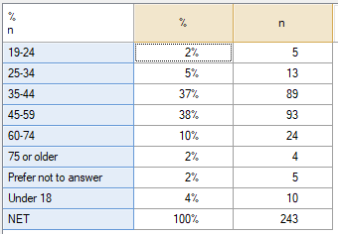
Age
Total sample; Unweighted; base n = 243; total n = 245; 2 missing

Slide 31
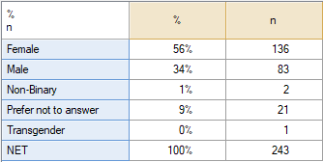
Gender
Total sample; Unweighted; base n = 243; total n = 245; 2 missing

Slide 32
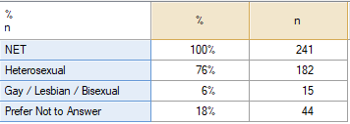
Sexual Orientation
Total sample; Unweighted; base n = 241; total n = 245; 4 missing

Slide 33
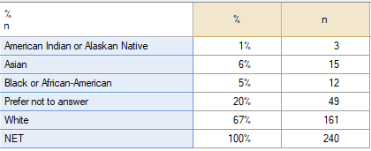
Race
Total sample; Unweighted; base n = 240; total n = 245; 5 missing

Slide 34
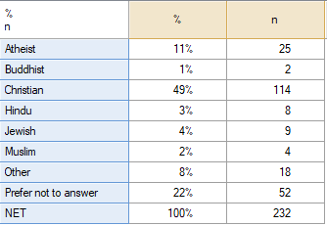
Religion
Total sample; Unweighted; base n = 232; total n = 245; 13 missing

Slide 35
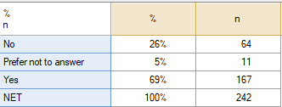
Do you have children under the age of 18 currently living with you?
Total sample; Unweighted; base n = 242; total n = 245; 3 missing

Slide 36
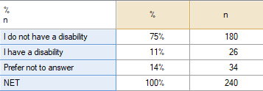
Disability status
Total sample; Unweighted; base n = 240; total n = 245; 5 missing

Slide 37
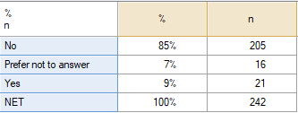
Veteran Status
Total sample; Unweighted; base n = 242; total n = 245; 3 missing

Slide 38
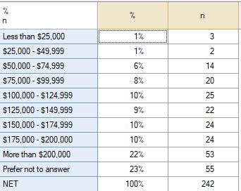
Total Household Income
Total sample; Unweighted; base n = 242; total n = 245; 3 missing

Slide 39
Home Ownership & Renting
Total sample; Unweighted; base n = 233; total n = 245; 12 missing

Slide 40
IDEA Committee Community Forum

Slide 41
Our Mission Statement
The mission of the Medway Inclusion, Diversity & Equity Advisory (IDEA) Committee is to provide feedback and recommendations to the Select Board geared toward policy development designed to continue and where appropriate enhance the promotion and fostering of Medway as a community that is inclusive and welcoming to all peoples of all backgrounds, beliefs, and cultures.
This mission statement shall in no way be construed to suggest that Medway does not excel in these efforts, but rather seeks to fully explore our standards, our practices, and our collective efforts today and to build upon them for an even better tomorrow.

Slide 42
Committee Timeline
Notes:
Need to update timeline with corrected dates and repost image.

Slide 43
Our Definitions
Diversity
Diversity is the presence of differences within our community
Equity
Equity is the opportunity for equal outcomes for all
Inclusion
Inclusion is fostering a community where everyone belongs

Slide 44
Focus Group Agenda
Focus Group Process
Completed Focus Groups
Town Administration & Select Board
Medway Schools Teachers & Administrators
Medway High School Students
Medway Police Department
Medway Marches
Council on Aging and Housing Authority
Small Business Community Representatives
Affordable Housing Committee/Affordable Housing Trust
Discussion Topic
Tell us about the greatest challenges and opportunities facing your organization as it relates to each:
Diversity
Equity
Inclusion

Slide 45
EXISTING CONDITIONS IN MEDWAY

Slide 46
Age Demographics
Medway currently has 13,325 residents
Increase in residents over 65 and a decrease in residents under 18
This trend is projected to continue through 2030
Key Takeaway: Medway’s population is aging.

Slide 47
Racial Demographics
In 2000, over 97% of Medway’s population identified as White Alone
In 2020, that number dropped to 88%
About 93% of Medway’s population speaks English as their primary language
Key Takeaways: Medway’s population is becoming more racially diverse, and we have close to 1,000 residents for whom English is not primary.

Slide 48
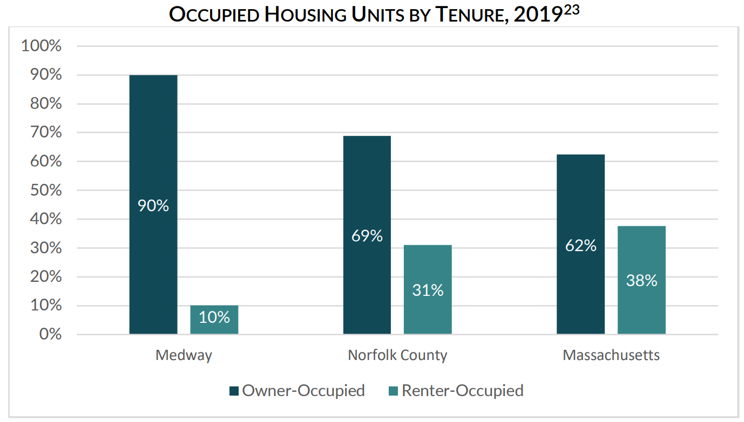
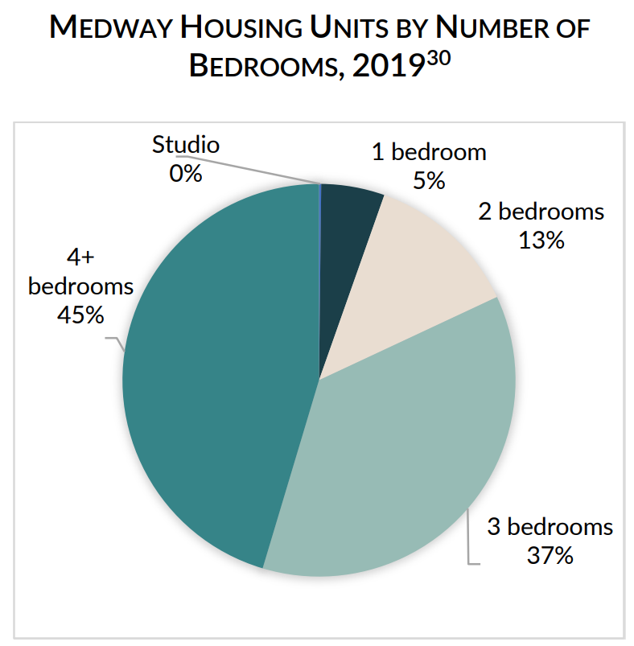
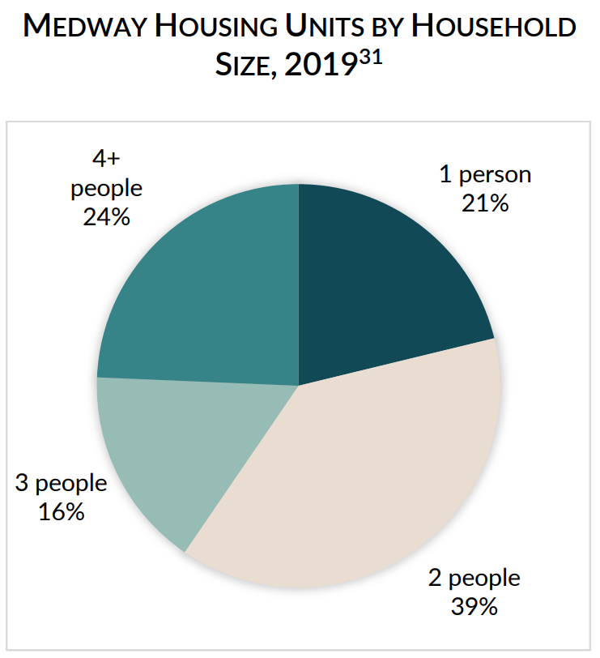
Housing
Over half of Medway households (54%) are estimated to be single or two-person households
90% of Medway’s housing is owner-occupied (only 10% rental units), compared to 69% in Norfolk County and 62% across Massachusetts
Smaller households tend to prefer alternatives to owner-occupied single family homes – rentals are smaller and more economically attainable
1,200 households in Medway (26%) are cost-burdened, meaning they spend more than 30% of their monthly income on housing costs
Additional rental units coming online in the future (under construction)
Key Takeaways: There is currently a mismatch between housing options and household sizes and needs – Medway needs more smaller housing options.

Slide 49
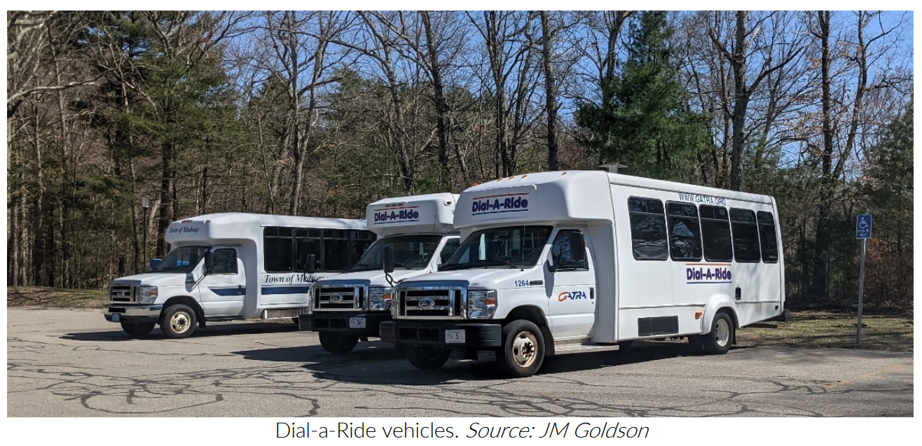
Accessibility & Transportation
Sidewalk coverage in Medway is a bit disconnected
Some primary roadways like Route 109, West St, Winthrop St, and Holliston St, do not connect residents to each other or to activity centers across town
Public transit (GATRA) has been significantly reduced due to the COVID-19 pandemic
Dial-A-Ride used to serve 2,000 passengers/year
Norfolk T shuttle used to serve over 7,600 passengers/year
Key Takeaways: Medway has challenges with accessibility due to disconnected network of sidewalks, and public transit options have declined while needs have increased, especially among seniors.

Slide 50
OUR FINDINGS & COMMON THEMES

Slide 51
Defining Diversity
What Does Diversity Mean?
Diversity is a broad term that includes, but is not limited to, differences in:
Mental Health
Age
Physical Ability
Learning Ability
Race/Ethnicity
Accessibility Needs
Language
Transportation
Public Service Needs
Gender/Identity
Religion
Socio-Economic Status
Thought/Ideology/Politics
Key Takeaway: Diversity is about far more than race.

Slide 52
Core Themes
Lack of awareness of Medway’s diversity
Town, schools, and police are committed to issues regarding diversity, equity, & inclusion
Town has demonstrated willingness to make changes to support inclusivity
Formation of IDEA Committee
Inclusion of menorah & kinara at Choate Park in December
Banners in Thayer House during holiday season
Expectations and realities can differ for residents who are part of under-represented populations
Diversity, Equity, & Inclusion are “hot button”, politically-charged issues, making it difficult to define, discuss, and reach consensus on them
Current social media climate in town creates hesitancy to speak up
Mental health issues are a growing concern among residents of all ages
Change is possible – will be incremental and require collective, collaborative effort

Slide 53
Specific Areas of Focus
Housing
Accessibility
Language
Transportation
Public Services
Information Sharing
Communication
Education of Residents
“Social Capital” Gap
Specific Populations
Police
Under-represented Populations
Schools
Seniors

Slide 54
Housing
Affordability
Single-family homes make up the majority of housing stock in Medway
Many cannot afford to stay in their homes (age in place) but lack options for where to go
Limited stock of rental units currently, more under construction
Price for rentals is unaffordable for many
Mismatch between household size (majority one- or two-person households) and housing stock (majority 3+ bedroom single-family homes)
Affordable Housing
Town has worked hard to meet state-mandated 10% threshold for affordable housing
Relatively few existing Medway residents qualify or appear interested
Affordable Housing in Medway may not be attractive to people who seek:
Public services
Public transportation
Translation services
Locally unavailable mental health resources
A more culturally-diverse population

Slide 55
Housing (cont’d)
Public Housing
Medway maintains four public housing facilities.
Lovering Heights and Kenney Drive are Over-55 state-funded housing
Aging complexes with poor funding, accessibility & transportation
No elevators
Limited access ramps
Mahan Circle is federally-funded Over-55 housing.
Better funding, amenities and accessibility
Maple Lane is federally-funded family housing
Limited number of units
Limited accessibility
Federally-funded properties offer better quality than state-funded locations
Housing Authority Issues
The state 5% set-aside demographic mandate unworkable
Lack of “minority” residents (as defined by state of MA DHCD) seeking housing in Medway
Residents from other towns not seeking to relocate to Medway
Older complexes
Lack of services
Lack of transportation

Slide 56
Accessibility
Language
English as a Second Language student population is rapidly increasing
Schools and Municipal buildings designed for English-speaking population
Lack of multilingual signage and services
Lack of translation services
Affects student, elderly, and immigrant residents
Documents and interpersonal communication affected
Expensive solutions
Prevents full participation in the community
Transportation
Limits students with unreliable transportation from participating in existing school programs, extracurricular activities
Limited elder transportation services are stressed by demand
Barrier to attracting new residents who rely on public transportation
Public Buildings & Services
Limited accessibility for persons with physical impairments
There is a lack of centralized resource and service delivery
Social workers located at Housing Authority and Senior Center – no resources for general resident population
No place for new residents to go when they arrive in Medway for direction
Often schools are the first interaction new families have
Schools not equipped to meet broad range of needs being presented

Slide 57
Information Sharing
Communication
Many residents do not feel informed about important happenings in town
Expand resources like business directory, centralized town calendar with events (not just board/committee meetings), more recorded meetings
Medway-specific Facebook pages have created division among residents
Lack of a platform for discussing DEI issues productively/respectfully
Education of Residents
Many residents do not know how small towns in MA work / municipal regs
Residents want to know how to become involved, what decisions they can impact, ways to elevate their ideas/concerns/questions
Lack of awareness of municipal/school hiring practices and requirements
“Social Capital” Gap
Long-time residents of Medway know who to contact with issues and how to get things done
Newer residents lack this knowledge, and there is currently no resource to help residents acquire it
Creates an inequity amongst residents based on who knows what/whom

Slide 58
Medway Police Department
The Medway Police Department has steadily diversified in recent years
Diversity efforts are dependent on meeting archaic civil service hiring requirements
Must hire from resident preferred list
Very little diversity availability
Outstanding candidates excluded by residency and test scores
Civil Service currently under review by state commission
30 by 30 program
National Program 30% of sworn officers be women by 2030
Medway not in position to meet this goal by 2030
2040 is more likely due to the relative youth of Medway’s force
Currently 12% of Medway’s officers are women
School Resource Officer (SRO) program meets state regulations related to training, arrests, program requirements
National concerns related to juvenile arrests by SROs addressed by Massachusetts law change during 2017.
Currently have a clinician (shared with Franklin), 3 years in and expecting to receive another.
Clinician is 100% grant funded by Dept. of Mental Health.
Second clinician will be split funded with Franklin
Will have 14 officers with Crisis Intervention Training
20-25% is recommended; Medway is currently 56% and continuing to train
MPD transparently shares data and statistics through annual reports

Slide 59
Under-Represented Populations
BIPOC and LGBTQ+
BIPOC and LGBTQ+ residents are underrepresented in the population
Some struggle to find commonality
Lack of adult role models and mentors for youth
May not be understood by long term residents
Challenges exist in attracting / retaining BIPOC and LGBTQ+ town and school employees
Schools seeing incidents targeted against students of color. Students in the LGBTQ+ community, and other minority populations
These incidents can have a ripple effect throughout the community
Lack of opportunity for transparency can be misunderstood and lead to resentment or feelings of isolation
Mental Health Issues
Significant rise in mental health issues among residents in recent years, especially during the pandemic
Growing concern about lack of resources to support residents’ mental health needs
Mental health issues can affect anyone at anytime
Can have detrimental impact on individuals, families, and the community
Resources targeted at specific population groups is desired
Youth/Students
Seniors
Underprivileged
Veterans

Slide 60
Medway Public Schools
Schools are seeing an increasingly diverse student population
Excellent after-school sports and program availability
Invested and caring teachers and staff
Schools supportive of differing cultures, races, genders, sexuality
More opportunity to expand learning opportunities exists
Broader educational materials than in the past
Excellent counselors
Adults work hard to make students feel comfortable
Surveys are common tools which sometimes fail to gain sought-after participation
Students below high school level are less exposed to diverse materials, support, and programs
Bullying between students in Middle School grades is an ongoing issue
Acceptance of differences among students is not universal
Special Needs
Sexuality
Gender
Race
Culture
Difficulty attracting and retaining diverse teachers and staff
Difficulty identifying needs of specific families and individuals
Difficulty sharing resources with other districts
Lack of longevity of successful efforts due to ever-changing school population

Slide 61
Seniors
Seniors being priced out of Medway, many unable to live independently – can’t afford housing, prescriptions, medical care, food, utilities, etc. – but do not have options for somewhere else to go
Lack of smaller, more affordable housing options to meet their needs
Role of Senior Center has changed dramatically over recent years
Used to be a place for connection, socialization, classes, lunches, and similar programming.
Now at least 70% of what Senior Center does is “putting out fires”, intervention, and providing human services resources
Applications for SNAP benefits
Fuel assistance
Mass Health
Seniors being dropped off at Senior Center need more care/services than Senior Center can provide
Many seniors lack access to/understanding of technology, risk falling victim to online scams
Particularly impacted by transportation issues – increasing medical appointments at farther distances, Town unable to provide support

Slide 62
Summary of Key Takeaways
Medway has become increasingly diverse in the last 20 years, but there remains a general lack of awareness about how the town has changed.
The Town, Schools, and Police have started providing resources to support changing needs of residents, and more needs to be done.
Specific areas of concern fall under the categories of:
Housing
Accessibility
Language/Translation Services
Transportation
Public Services
Information Sharing
Communication
Education of Residents
“Social Capital” Gap
Current climate is highly politicized, making discussion of these issues more challenging
There is a need for resources to help those in the majority consider the needs of those in the minority.
Equity & Inclusion = Access
How do we ensure we continually consider the needs of others for access to all Medway has to offer?

Slide 63
Next Steps
The IDEA Committee has created a survey for anyone who lives or works in Medway
Survey Link:
Survey will be open until Tuesday, May 31, 2022
Approximately 7-10 minutes to complete
Opportunity to answer the same question asked in all focus groups:
What are the greatest opportunities and challenges as it relates to diversity, equity, and inclusion in Medway?

Slide 64
Questions?

