Slide 1
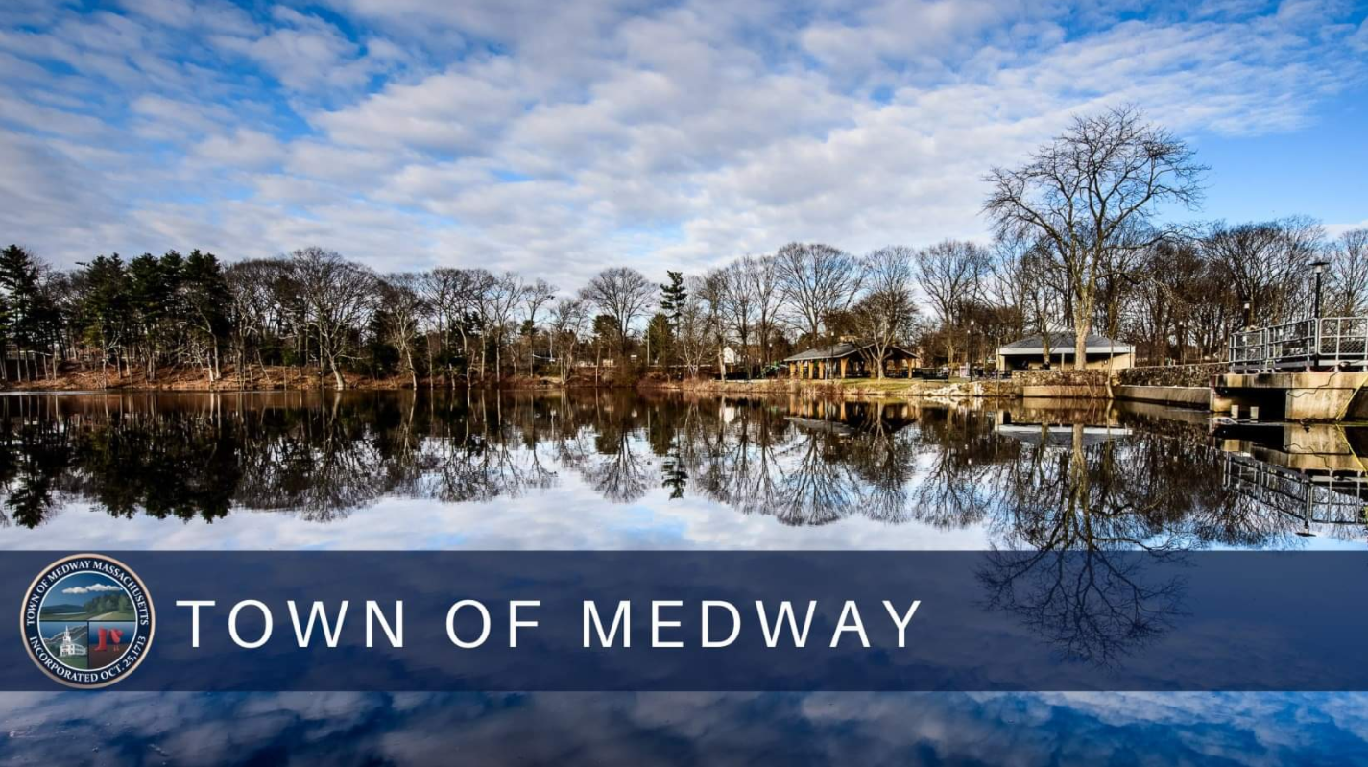
IDEA Committee Community Forum

Slide 2
Committee Members
Select Board issued Committee Charge on December 7, 2020 (updated April 2021), specifying nine (9) members to be appointed as follows:
One (1) member from the Select Board
One (1) member recommended by the School Committee
One (1) member recommended by the Council on Aging
One (1) member who is a resident of Medway and an employee of the Medway Police Department
One (1) Medway Business Owner or Civic Organization Member from an under-represented population
Four (4) residents of the Town, one of whom shall be selected from and represent Medway’s BIPOC population
Daniel Kerls | Chair, Resident
John Foresto | Vice-Chair, Select Board Representative
Lt. William Kingsbury | Police Department Representative
Judith Lane | Council on Aging Representative
Susan Dietrich | School Committee Representative
Andrea Crow Henry | Civic Leader
Khalid Abdi | Member
Marques Crosby | Member
Brian Sharkey | Member

Slide 3
Our Mission Statement
The mission of the Medway Inclusion, Diversity & Equity Advisory (IDEA) Committee is to provide feedback and recommendations to the Select Board geared toward policy development designed to continue and where appropriate enhance the promotion and fostering of Medway as a community that is inclusive and welcoming to all peoples of all backgrounds, beliefs, and cultures.
This mission statement shall in no way be construed to suggest that Medway does not excel in these efforts, but rather seeks to fully explore our standards, our practices, and our collective efforts today and to build upon them for an even better tomorrow.

Slide 4
Committee Timeline
Notes:
Need to update timeline with corrected dates and repost image.

Slide 5
Our Definitions
Diversity
Diversity is the presence of differences within our community
Equity
Equity is the opportunity for equal outcomes for all
Inclusion
Inclusion is fostering a community where everyone belongs

Slide 6
Focus Group Agenda
Focus Group Process
Completed Focus Groups
Town Administration & Select Board
Medway Schools Teachers & Administrators
Medway High School Students
Medway Police Department
Medway Marches
Council on Aging and Housing Authority
Small Business Community Representatives
Affordable Housing Committee/Affordable Housing Trust
Discussion Topic
Tell us about the greatest challenges and opportunities facing your organization as it relates to each:
Diversity
Equity
Inclusion

Slide 7
EXISTING CONDITIONS IN MEDWAY

Slide 8
Age Demographics
Medway currently has 13,325 residents
Increase in residents over 65 and a decrease in residents under 18
This trend is projected to continue through 2030
Key Takeaway: Medway’s population is aging.

Slide 9
Racial Demographics
In 2000, over 97% of Medway’s population identified as White Alone
In 2020, that number dropped to 88%
About 93% of Medway’s population speaks English as their primary language
Key Takeaways: Medway’s population is becoming more racially diverse, and we have close to 1,000 residents for whom English is not primary.

Slide 10
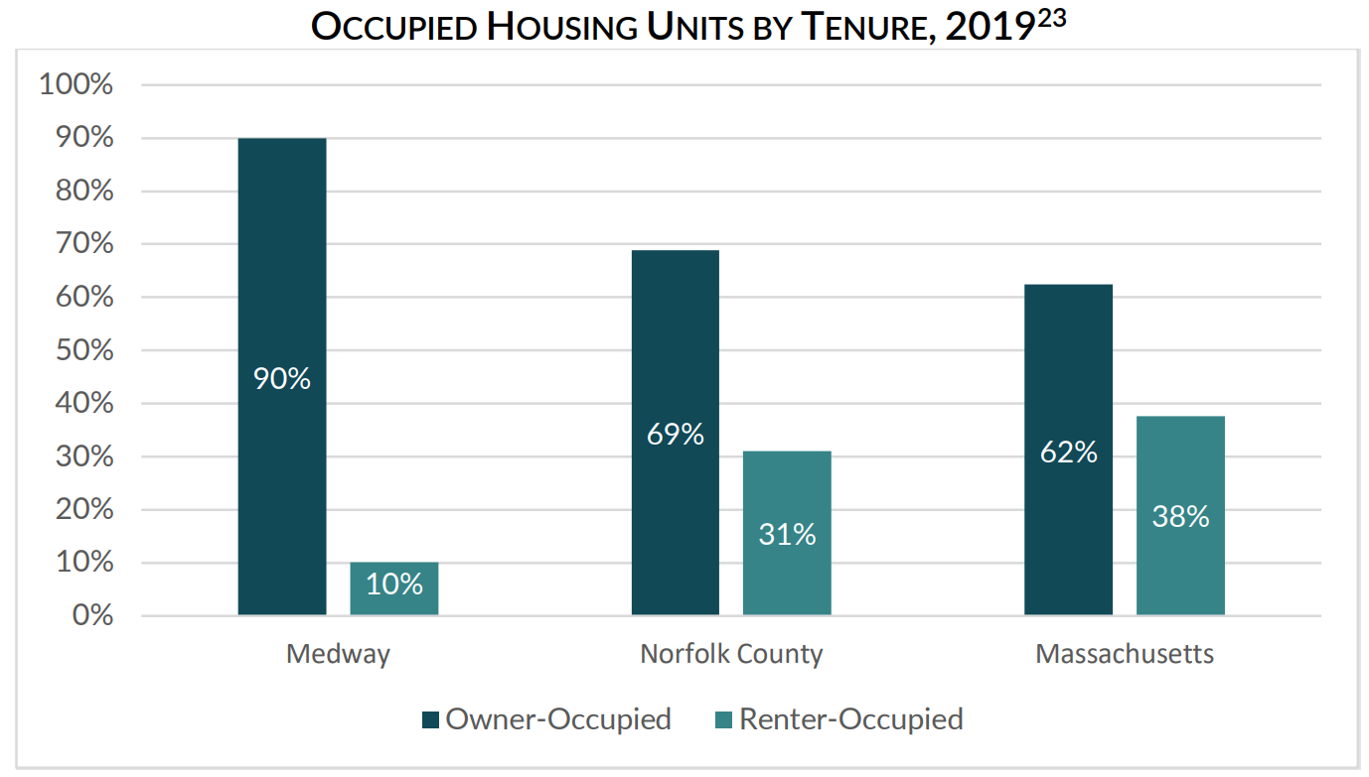
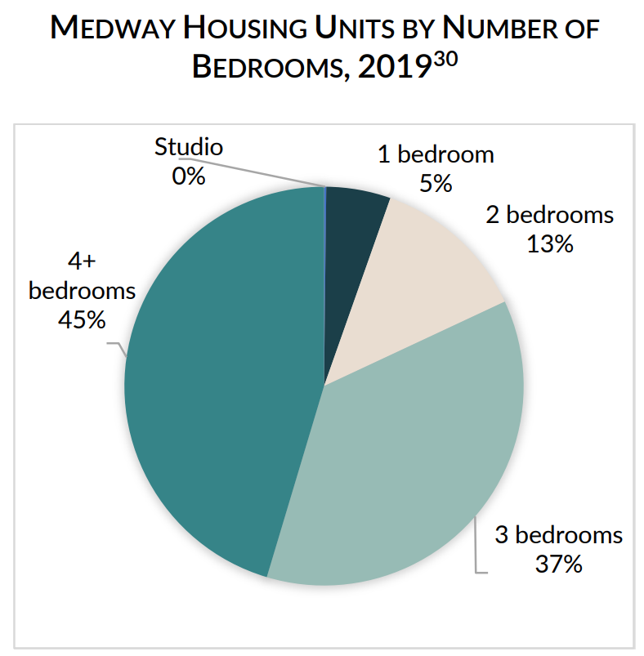
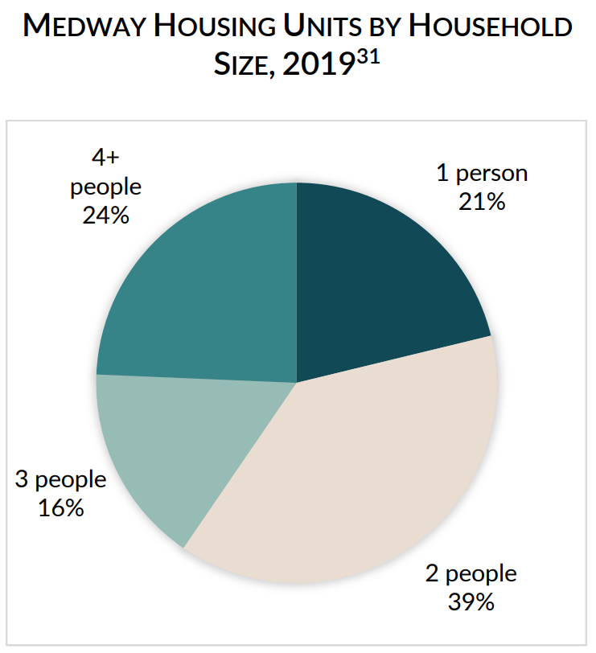
Housing
Over half of Medway households (54%) are estimated to be single or two-person households
90% of Medway’s housing is owner-occupied (only 10% rental units), compared to 69% in Norfolk County and 62% across Massachusetts
Smaller households tend to prefer alternatives to owner-occupied single family homes – rentals are smaller and more economically attainable
1,200 households in Medway (26%) are cost-burdened, meaning they spend more than 30% of their monthly income on housing costs
Additional rental units coming online in the future (under construction)
Key Takeaways: There is currently a mismatch between housing options and household sizes and needs – Medway needs more smaller housing options.

Slide 11
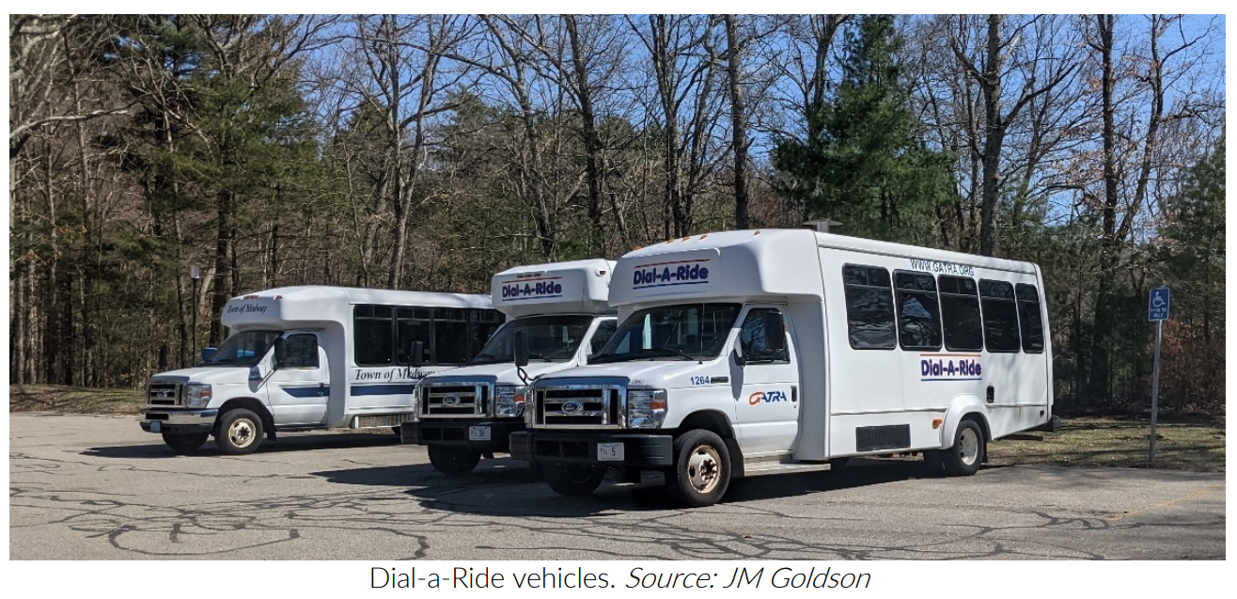
Accessibility & Transportation
Sidewalk coverage in Medway is a bit disconnected
Some primary roadways like Route 109, West St, Winthrop St, and Holliston St, do not connect residents to each other or to activity centers across town
Public transit (GATRA) has been significantly reduced due to the COVID-19 pandemic
Dial-A-Ride used to serve 2,000 passengers/year
Norfolk T shuttle used to serve over 7,600 passengers/year
Key Takeaways: Medway has challenges with accessibility due to disconnected network of sidewalks, and public transit options have declined while needs have increased, especially among seniors.

Slide 12
OUR FINDINGS & COMMON THEMES

Slide 13
Defining Diversity
What Does Diversity Mean?
Diversity is a broad term that includes, but is not limited to, differences in:
Mental Health
Age
Physical Ability
Learning Ability
Race/Ethnicity
Accessibility Needs
Language
Transportation
Public Service Needs
Gender/Identity
Religion
Socio-Economic Status
Thought/Ideology/Politics
Key Takeaway: Diversity is about far more than race.

Slide 14
Core Themes
Lack of awareness of Medway’s diversity
Town, schools, and police are committed to issues regarding diversity, equity, & inclusion
Town has demonstrated willingness to make changes to support inclusivity
Formation of IDEA Committee
Inclusion of menorah & kinara at Choate Park in December
Banners in Thayer House during holiday season
Expectations and realities can differ for residents who are part of under-represented populations
Diversity, Equity, & Inclusion are “hot button”, politically-charged issues, making it difficult to define, discuss, and reach consensus on them
Current social media climate in town creates hesitancy to speak up
Mental health issues are a growing concern among residents of all ages
Change is possible – will be incremental and require collective, collaborative effort

Slide 15
Specific Areas of Focus
Housing
Accessibility
Language
Transportation
Public Services
Information Sharing
Communication
Education of Residents
“Social Capital” Gap
Specific Populations
Police
Under-represented Populations
Schools
Seniors

Slide 16
Housing
Affordability
Single-family homes make up the majority of housing stock in Medway
Many cannot afford to stay in their homes (age in place) but lack options for where to go
Limited stock of rental units currently, more under construction
Price for rentals is unaffordable for many
Mismatch between household size (majority one- or two-person households) and housing stock (majority 3+ bedroom single-family homes)
Affordable Housing
Town has worked hard to meet state-mandated 10% threshold for affordable housing
Relatively few existing Medway residents qualify or appear interested
Affordable Housing in Medway may not be attractive to people who seek:
Public services
Public transportation
Translation services
Locally unavailable mental health resources
A more culturally-diverse population

Slide 17
Housing (cont’d)
Public Housing
Medway maintains four public housing facilities.
Lovering Heights and Kenney Drive are Over-55 state-funded housing
Aging complexes with poor funding, accessibility & transportation
No elevators
Limited access ramps
Mahan Circle is federally-funded Over-55 housing.
Better funding, amenities and accessibility
Maple Lane is federally-funded family housing
Limited number of units
Limited accessibility
Federally-funded properties offer better quality than state-funded locations
Housing Authority Issues
The state 5% set-aside demographic mandate unworkable
Lack of “minority” residents (as defined by state of MA DHCD) seeking housing in Medway
Residents from other towns not seeking to relocate to Medway
Older complexes
Lack of services
Lack of transportation

Slide 18
Accessibility
Language
English as a Second Language student population is rapidly increasing
Schools and Municipal buildings designed for English-speaking population
Lack of multilingual signage and services
Lack of translation services
Affects student, elderly, and immigrant residents
Documents and interpersonal communication affected
Expensive solutions
Prevents full participation in the community
Transportation
Limits students with unreliable transportation from participating in existing school programs, extracurricular activities
Limited elder transportation services are stressed by demand
Barrier to attracting new residents who rely on public transportation
Public Buildings & Services
Limited accessibility for persons with physical impairments
There is a lack of centralized resource and service delivery
Social workers located at Housing Authority and Senior Center – no resources for general resident population
No place for new residents to go when they arrive in Medway for direction
Often schools are the first interaction new families have
Schools not equipped to meet broad range of needs being presented

Slide 19
Information Sharing
Communication
Many residents do not feel informed about important happenings in town
Expand resources like business directory, centralized town calendar with events (not just board/committee meetings), more recorded meetings
Medway-specific Facebook pages have created division among residents
Lack of a platform for discussing DEI issues productively/respectfully
Education of Residents
Many residents do not know how small towns in MA work / municipal regs
Residents want to know how to become involved, what decisions they can impact, ways to elevate their ideas/concerns/questions
Lack of awareness of municipal/school hiring practices and requirements
“Social Capital” Gap
Long-time residents of Medway know who to contact with issues and how to get things done
Newer residents lack this knowledge, and there is currently no resource to help residents acquire it
Creates an inequity amongst residents based on who knows what/whom

Slide 20
Medway Police Department
The Medway Police Department has steadily diversified in recent years
Diversity efforts are dependent on meeting archaic civil service hiring requirements
Must hire from resident preferred list
Very little diversity availability
Outstanding candidates excluded by residency and test scores
Civil Service currently under review by state commission
30 by 30 program
National Program 30% of sworn officers be women by 2030
Medway not in position to meet this goal by 2030
2040 is more likely due to the relative youth of Medway’s force
Currently 12% of Medway’s officers are women
School Resource Officer (SRO) program meets state regulations related to training, arrests, program requirements
National concerns related to juvenile arrests by SROs addressed by Massachusetts law change during 2017.
Currently have a clinician (shared with Franklin), 3 years in and expecting to receive another.
Clinician is 100% grant funded by Dept. of Mental Health.
Second clinician will be split funded with Franklin
Will have 14 officers with Crisis Intervention Training
20-25% is recommended; Medway is currently 56% and continuing to train
MPD transparently shares data and statistics through annual reports

Slide 21
Under-Represented Populations
BIPOC and LGBTQ+
BIPOC and LGBTQ+ residents are underrepresented in the population
Some struggle to find commonality and community
Lack of adult role models and mentors for youth
Challenges exist in attracting / retaining BIPOC and LGBTQ+ town and school employees
Schools seeing incidents targeted against students of color, students in the LGBTQ+ community, and other minority populations
These incidents can have a ripple effect throughout the community
Lack of opportunity for transparency can be misunderstood and lead to resentment or feelings of isolation
Mental Health Issues
Significant rise in mental health issues among residents in recent years, especially during the pandemic
Growing concern about lack of resources to support residents’ mental health needs
Mental health issues can affect anyone at anytime
Can have detrimental impact on individuals, families, and the community
Resources targeted at specific population groups is desired
Youth/Students
Seniors
Underprivileged
Veterans

Slide 22
Medway Public Schools
Schools are seeing an increasingly diverse student population
Excellent after-school sports and program availability
Invested and caring teachers and staff
Schools supportive of differing cultures, races, genders, sexuality
More opportunity to expand learning exists
Broader educational materials than in the past
Excellent counselors
Adults work hard to make students feel comfortable
Surveys are common tools which sometimes fail to gain sought-after participation
Students below high school level are less exposed to diverse materials, support, and programs
Bullying between students in Middle School grades in particular is an ongoing issue
Acceptance of differences among students is not universal
Special Needs
Sexuality
Gender
Race
Culture
Difficulty attracting and retaining diverse teachers and staff
Difficulty identifying needs of specific families and individuals
Difficulty sharing resources with other districts
Lack of longevity of successful efforts due to ever-changing school population

Slide 23
Seniors
Seniors being priced out of Medway, many unable to live independently – can’t afford housing, prescriptions, medical care, food, utilities, etc. – but do not have options for somewhere else to go
Lack of smaller, more affordable housing options to meet their needs
Role of Senior Center has changed dramatically over recent years
Used to be a place for connection, socialization, classes, lunches, and similar programming.
Now at least 70% of what Senior Center does is “putting out fires”, intervention, and providing human services resources
Applications for SNAP benefits
Fuel assistance
Mass Health
Seniors being dropped off at Senior Center need more care/services than Senior Center can provide
Many seniors lack access to/understanding of technology, risk falling victim to online scams
Particularly impacted by transportation issues – increasing medical appointments at farther distances, Town unable to provide support

Slide 24
Summary of Key Takeaways
Medway has become increasingly diverse in the last 20 years, but there remains a general lack of awareness about how the town has changed.
The Town, Schools, and Police have started providing resources to support changing needs of residents, and more needs to be done.
Specific areas of concern fall under the categories of:
Housing
Accessibility
Language/Translation Services
Transportation
Public Services
Information Sharing
Communication
Education of Residents
“Social Capital” Gap
Current climate is highly politicized, making discussion of these issues more challenging
There is a need for resources to help those in the majority consider the needs of those in the minority.
Equity & Inclusion = Access
How do we ensure we continually consider the needs of others for access to all Medway has to offer?

Slide 25
Next Steps
The IDEA Committee has created a survey for anyone who lives or works in Medway
Survey Link: IDEA Community Survey May 2022
Survey will be open until Friday, June 17, 2022
Approximately 7-10 minutes to complete
Opportunity to share feedback in open-ended format (no character limit), just as all focus group participants did:
Please provide any additional comments or suggestions that you have which may inform the IDEA committee’s charge with gathering information related to diversity, equity, and inclusion here in Medway.

Slide 26
Questions?

